Slide 1
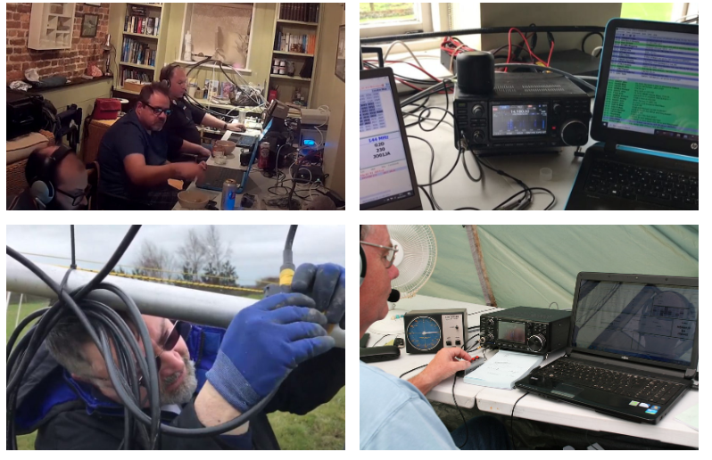
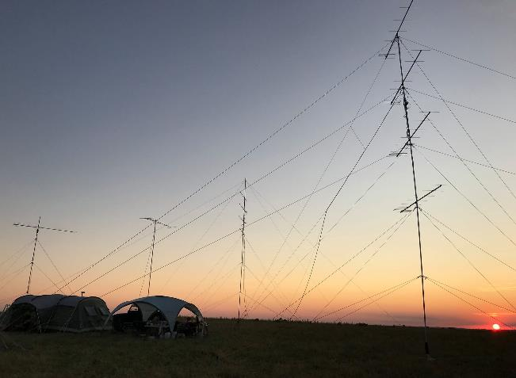
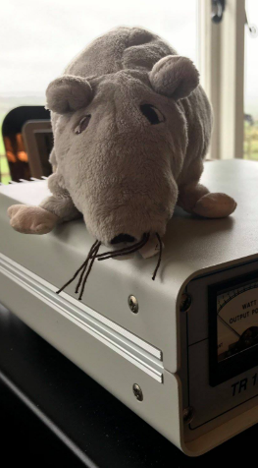
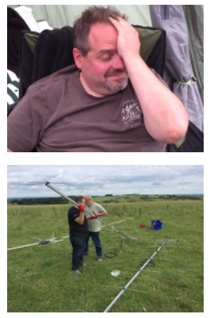
A Beginner’s Guide to VHF DXing and Contesting
A presentation to The Radio Society of Harrow – 12th March 2021
M0ICR - Carl Ratcliffe
Drowned Rats Radio Group Club Sec
m0icr@drownedrats.uk
www.m0icr.com m0icr@live.com
G2D / G3RAT - Drowned Rats Radio Group - www.g3rat.com

Slide 2
A Beginner’s Guide to VHF DXing and Contesting
A presentation to The Radio Society of Harrow – 12th March 2021
M0ICR - Carl Ratcliffe
Drowned Rats Radio Group Club Sec
m0icr@drownedrats.uk
www.m0icr.com m0icr@live.com
G2D / G3RAT - Drowned Rats Radio Group - www.g3rat.com

Slide 3
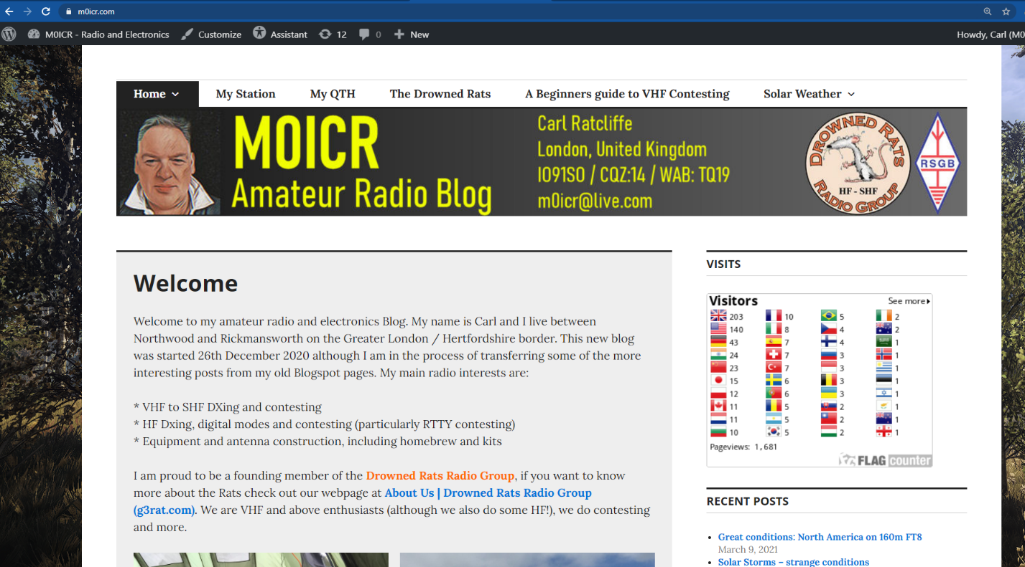
You can find this presentation and more here ….
www.m0icr.com
G2D / G3RAT - Drowned Rats Radio Group - www.g3rat.com

Slide 4
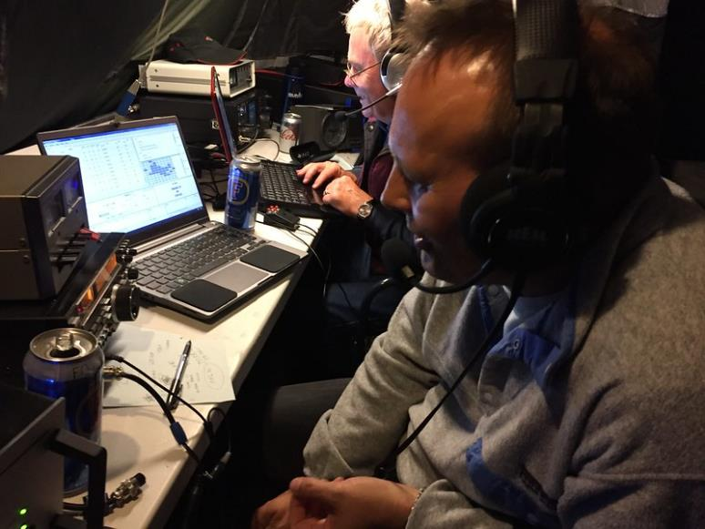
Topics to be covered
1. Getting Started
Why?
Radio
Antenna
Location
Logging and other tools
Contesting – UKAC
RSGB Contests – website and rules
Taking Part in a UKAC
Other Contests
VHF DXing outside Contesting
4. The Drowned Rats
G2D / G3RAT - Drowned Rats Radio Group - www.g3rat.com

Slide 5
Part One
Getting Started
G2D / G3RAT - Drowned Rats Radio Group - www.g3rat.com

Slide 6
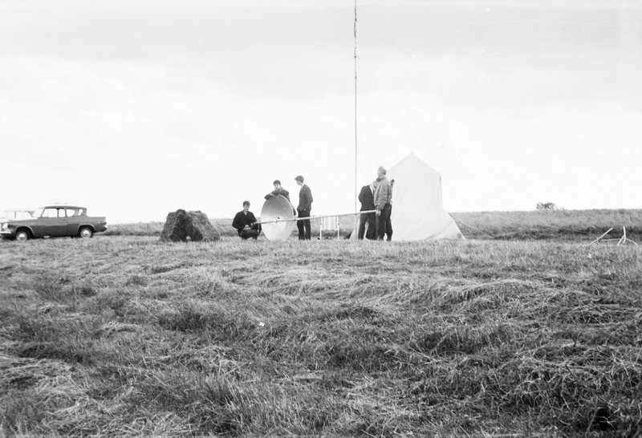
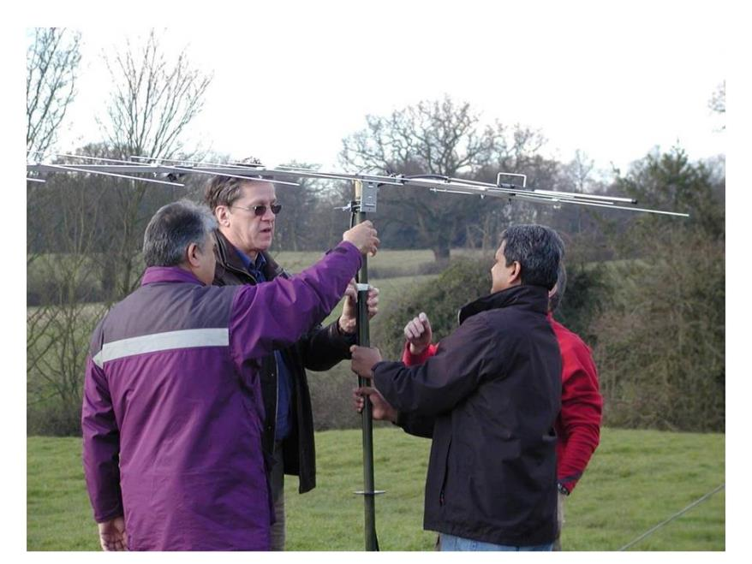
A history lesson!
G2D / G3RAT - Drowned Rats Radio Group - www.g3rat.com

Slide 7
Getting Started - Why
It’s fun
Great community
Always learning
It’s not like HF Contesting
Friendly
Shorter
Easier to compete?
G2D / G3RAT - Drowned Rats Radio Group - www.g3rat.com

Slide 8
Getting Started – the most important slide!
What makes a great station?
DXing is a ‘game of Decibels’
Operator Skill
Location
Antenna and feedline
Radio features
Conditions
Power
… but in what order?
A (controversial?) discussion point!
Its all about dB gain and dB loss
Against a backdrop of ‘atmospheric’ loss on a given path over distance and noise
Antenna Gain works for TX and RX
Increasing your output power only works one way
Reduce losses / maximise your gain / reduce noise (switch off those LED lights!!)
Learn to hear better!
Read your radio’s manual, learn to use the attenuator, RF gain, pre-amps, DSP and filters, audio compression
HAVE FUN
And never stop learning
G2D / G3RAT - Drowned Rats Radio Group - www.g3rat.com

Slide 9
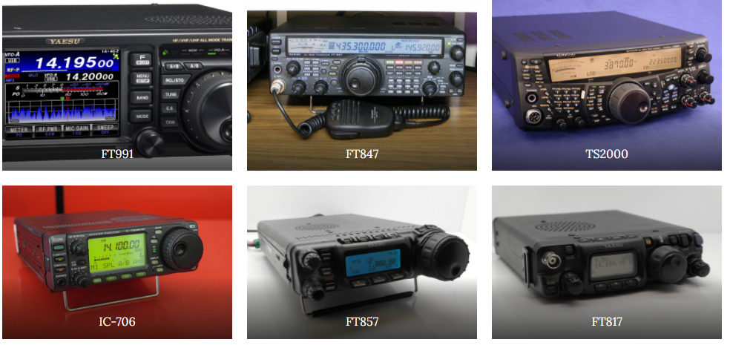
Getting Started - Radio
A selection of modern radios
G2D / G3RAT - Drowned Rats Radio Group - www.g3rat.com

Slide 10
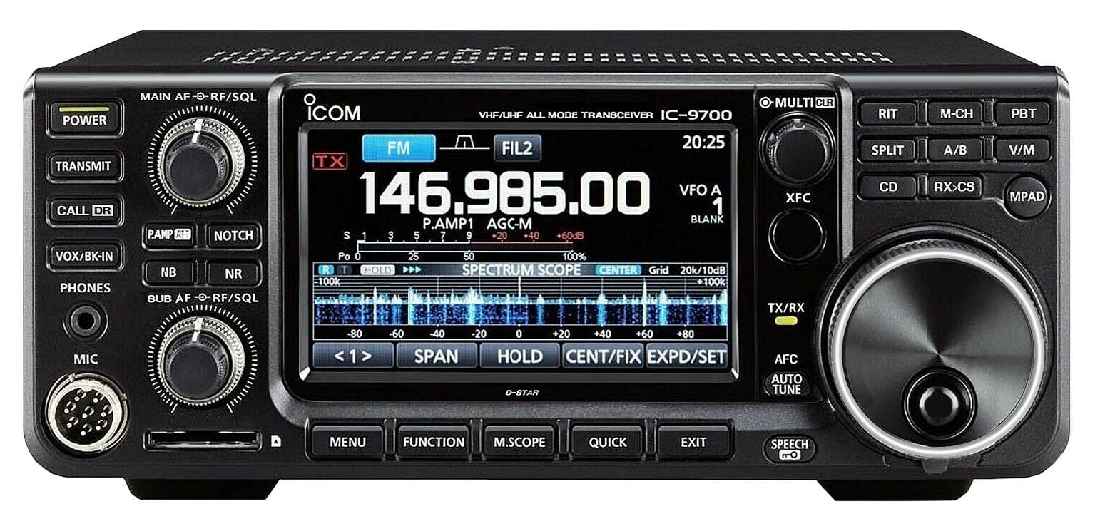
Getting Started - Radio
Icom 9700 – 2m, 70cm, 23cm
G2D / G3RAT - Drowned Rats Radio Group - www.g3rat.com

Slide 11
Getting Started - Radio
Oldies but goldies!
G2D / G3RAT - Drowned Rats Radio Group - www.g3rat.com

Slide 12
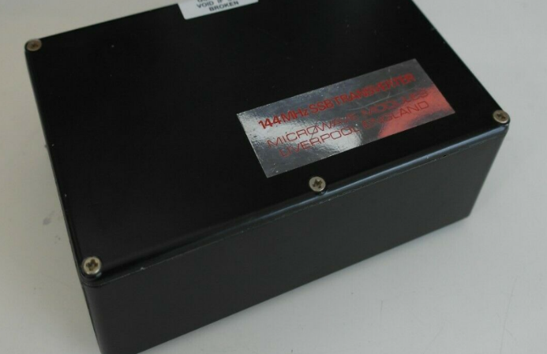
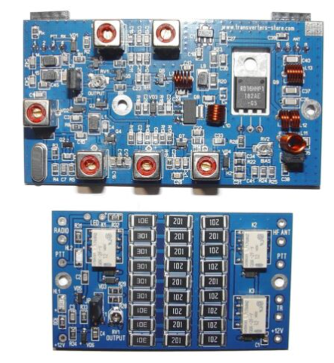
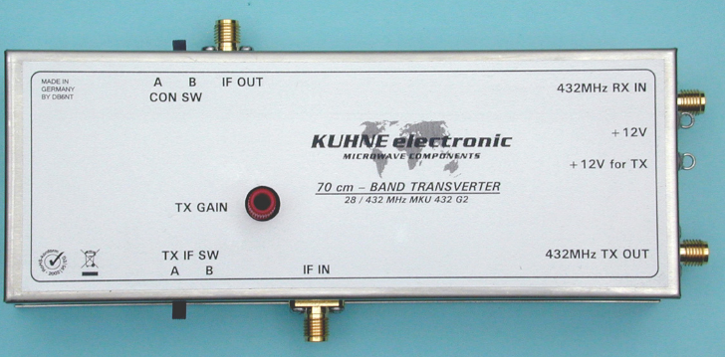
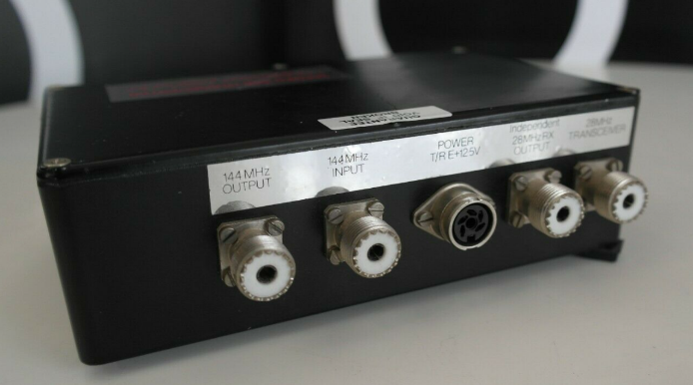
Getting Started – Radio - transverters
£30 rally/ebay
£400
£30 ebay
G2D / G3RAT - Drowned Rats Radio Group - www.g3rat.com

Slide 13
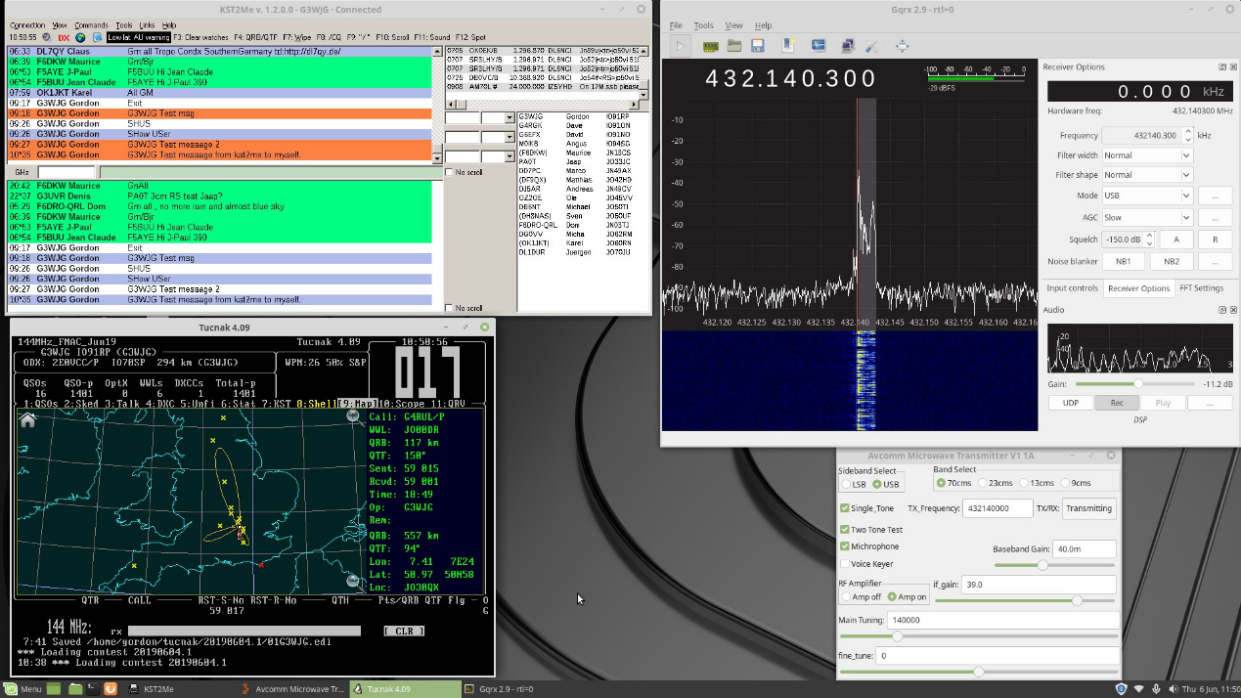
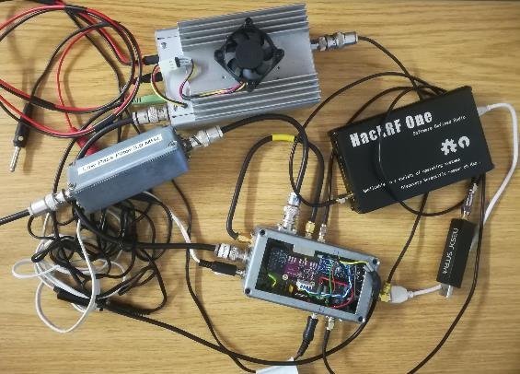
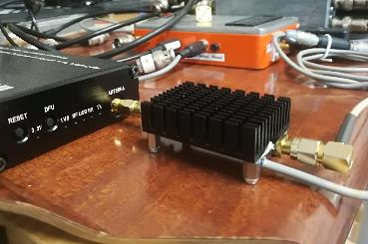
Homebrew – recent projects by Rats
Practical HF to GHz transceiver using GNU Radio / HackRF and RPi
By Gordon G3WJG
G2D / G3RAT - Drowned Rats Radio Group - www.g3rat.com

Slide 14
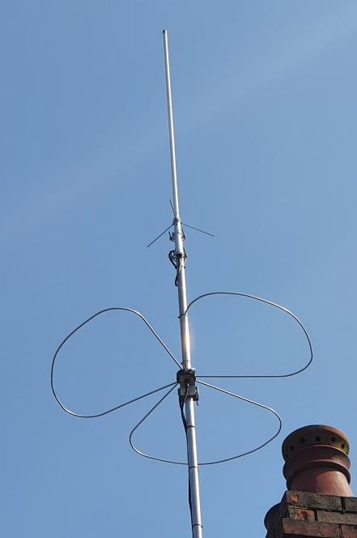
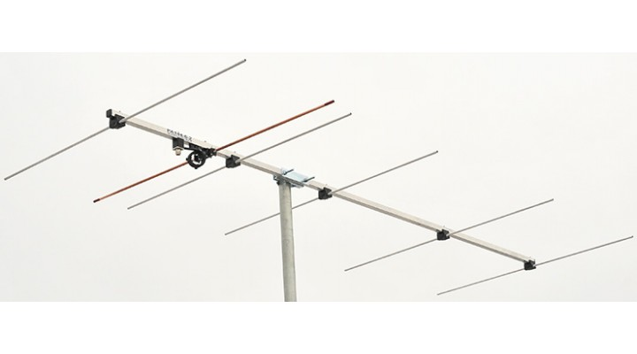
Getting Started - Antenna
Polarisation
Verticals
Beams
Dual banders
Novel designs
Halo
HB9CV
Moxon
Big Wheel
Slim Jim etc etc
…. But anything is better than nothing, even a dipole
G2D / G3RAT - Drowned Rats Radio Group - www.g3rat.com

Slide 15
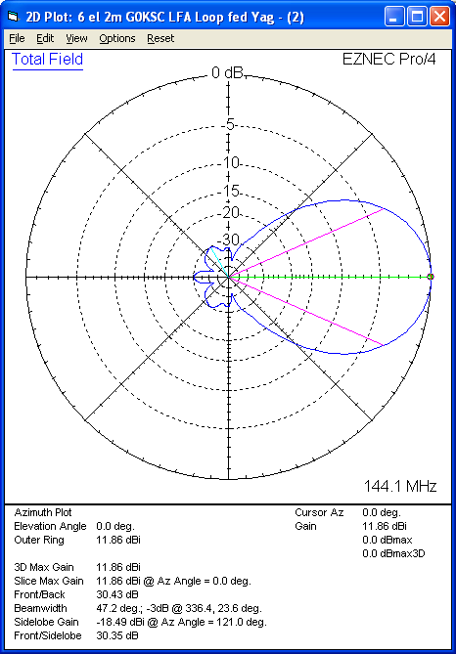
Getting Started - Antenna
G2D / G3RAT - Drowned Rats Radio Group - www.g3rat.com

Slide 16
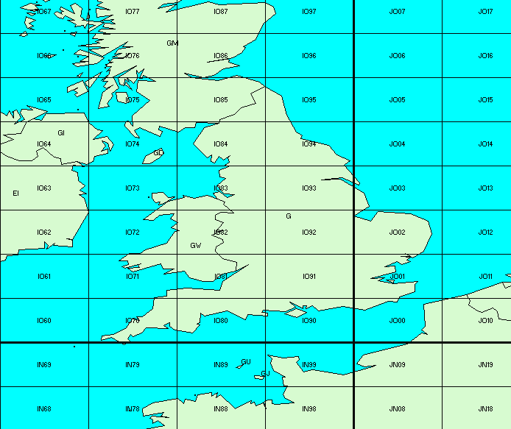
Getting Started – Antenna
Typical 2m 6 ele beam
2.2 m beam length
11.5dBi Gain
47 degree beamwidth
340⁰
9
4
3
1
2
7
6
5
8
G2D / G3RAT - Drowned Rats Radio Group - www.g3rat.com

Slide 17
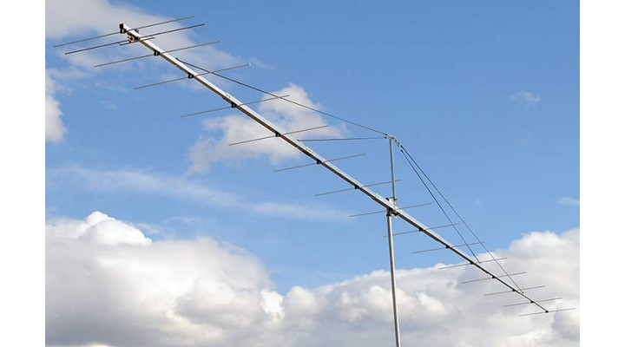
Getting Started - Antenna
Typical 2m 12 ele beam
7 m boom length
15.8 dBi Gain
31 degree beamwidth
340⁰
9
4
3
1
2
7
6
5
8
G2D / G3RAT - Drowned Rats Radio Group - www.g3rat.com

Slide 18
Getting Started - Antenna
Typical 2m 12 ele beam
7 m boom length
15.8 dBi Gain
31 degree beamwidth
315⁰
9
4
3
1
2
7
6
5
8
G2D / G3RAT - Drowned Rats Radio Group - www.g3rat.com

Slide 19
Getting Started - Antenna
Typical 2m 12 ele beam
7 m boom length
15.8 dBi Gain
31 degree beamwidth
300⁰
9
4
3
1
2
7
6
5
8
G2D / G3RAT - Drowned Rats Radio Group - www.g3rat.com

Slide 20
Getting Started - Antenna
Typical 2m 12 ele beam
7 m boom length
15.8 dBi Gain
31 degree beamwidth
250⁰
9
4
3
1
2
7
6
5
8
G2D / G3RAT - Drowned Rats Radio Group - www.g3rat.com

Slide 21
Getting Started - Antenna
Typical 2m 12 ele beam
7 m boom length
15.8 dBi Gain
31 degree beamwidth
130⁰
9
4
3
1
2
7
6
5
8
G2D / G3RAT - Drowned Rats Radio Group - www.g3rat.com

Slide 22
Getting Started - Antenna
Typical 2m 12 ele beam
7 m boom length
15.8 dBi Gain
31 degree beamwidth
80⁰
9
4
3
1
2
7
6
5
8
G2D / G3RAT - Drowned Rats Radio Group - www.g3rat.com

Slide 23
Getting Started - Antenna
Typical 2m 12 ele beam
7 m boom length
15.8 dBi Gain
31 degree beamwidth
10⁰
9
4
3
1
2
7
6
5
8
G2D / G3RAT - Drowned Rats Radio Group - www.g3rat.com

Slide 24
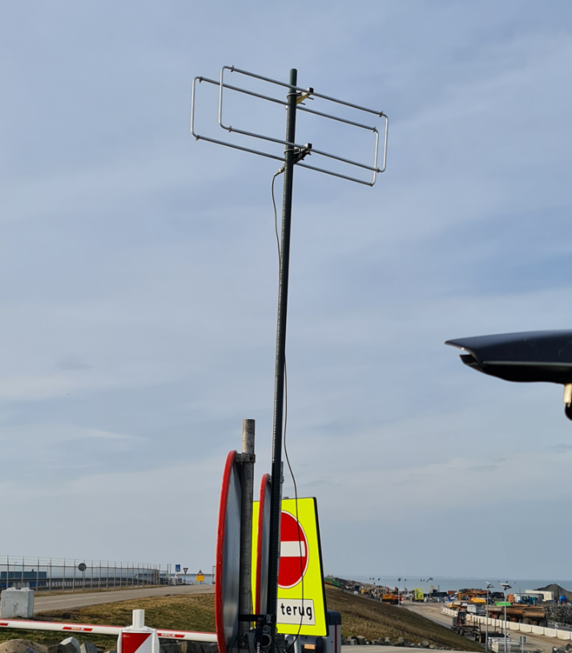
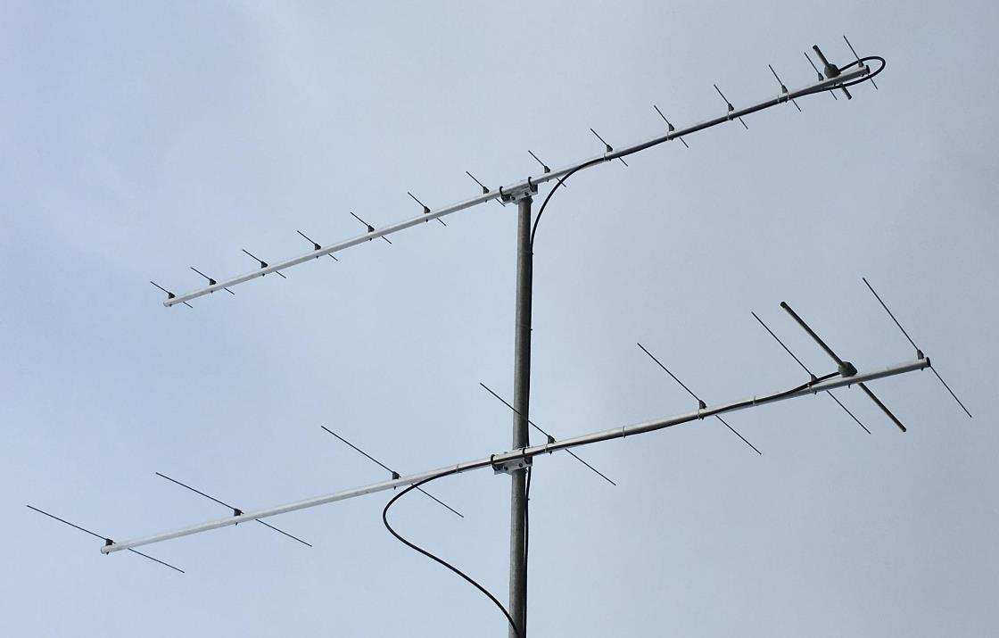
Getting Started - Antenna
Buy or make your own!
G2D / G3RAT - Drowned Rats Radio Group - www.g3rat.com

Slide 25
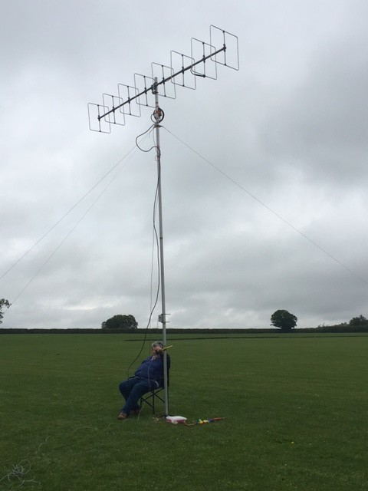
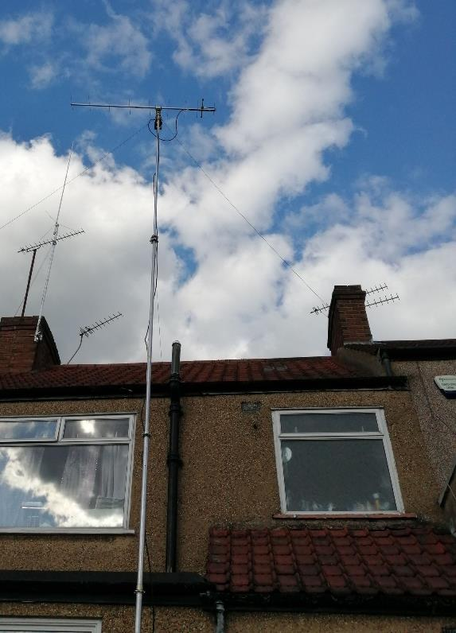
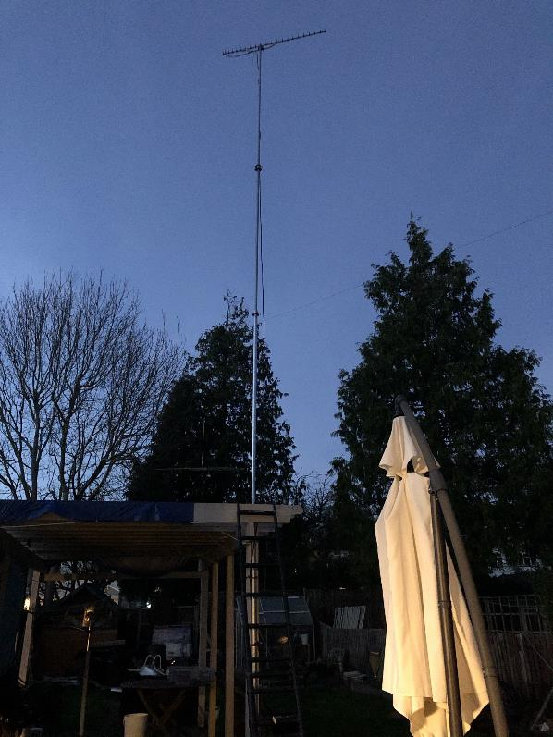
Getting Started - Antenna
G2D / G3RAT - Drowned Rats Radio Group - www.g3rat.com

Slide 26
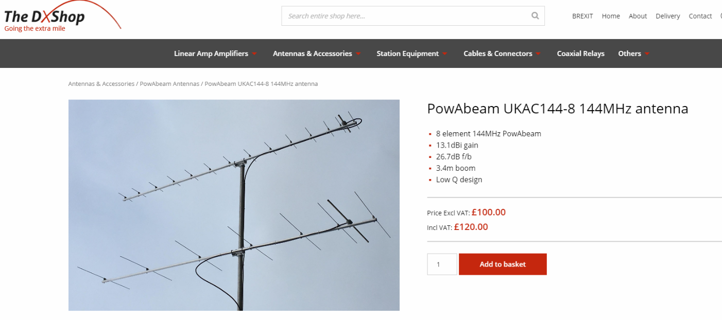
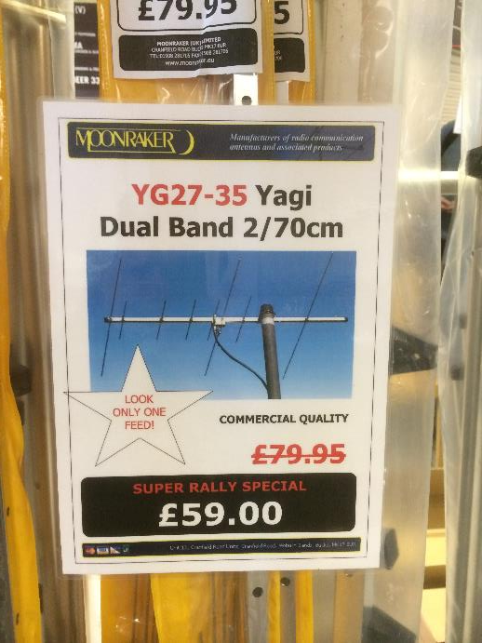
Getting Started - Antenna
https://thedxshop.com/product/powabeam-ukac144-8-144mhz-antenna/
G2D / G3RAT - Drowned Rats Radio Group - www.g3rat.com

Slide 27
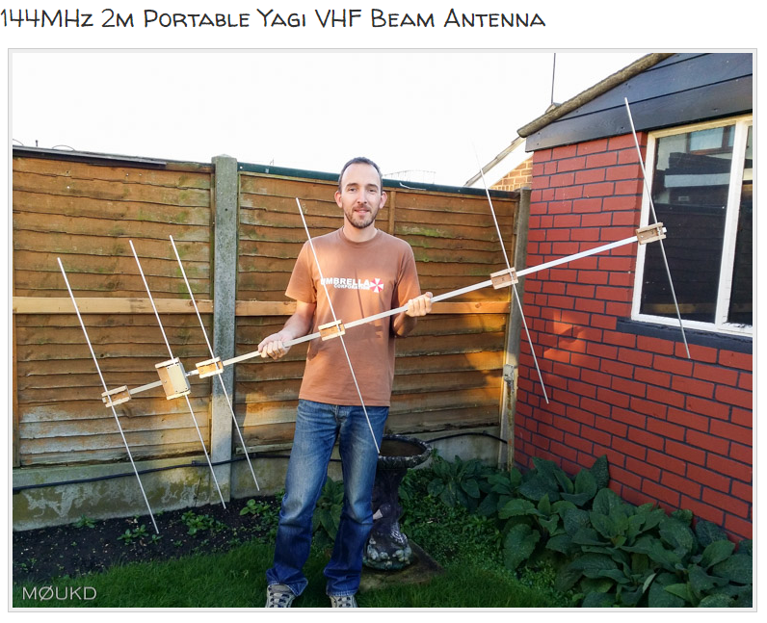
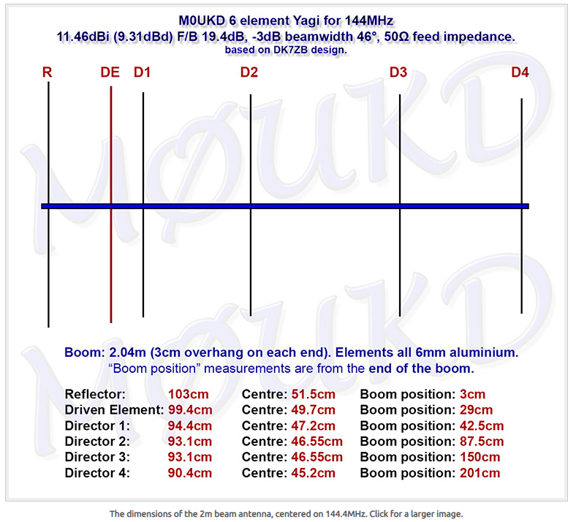
Getting Started – Roll your own – A club project?
https://m0ukd.com/homebrew/antennas/144mhz-2m-portable-yagi-vhf-beam-antenna/
G2D / G3RAT - Drowned Rats Radio Group - www.g3rat.com

Slide 28
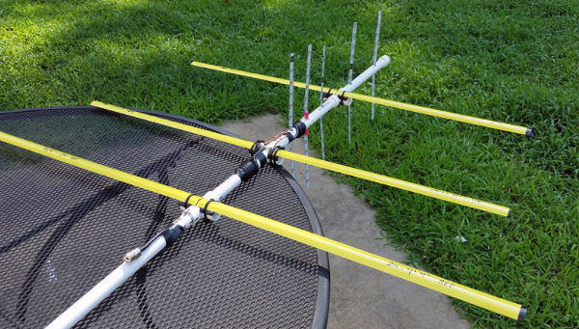
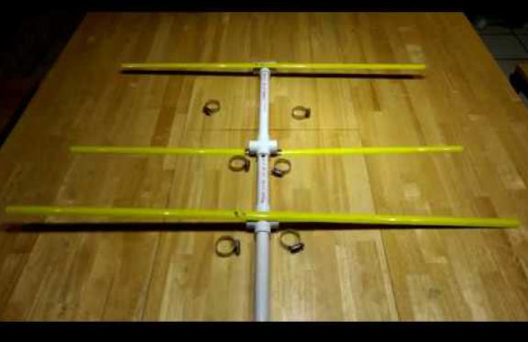
Getting Started – Roll your own – A club project?
Ideas for club projects?
https://qrznow.com/tape-measure-yagi-beam-antenna-ham-radio-qa/
https://youtu.be/BmHoQrDfw-0
Followed by a Foxhunt?
G2D / G3RAT - Drowned Rats Radio Group - www.g3rat.com

Slide 29
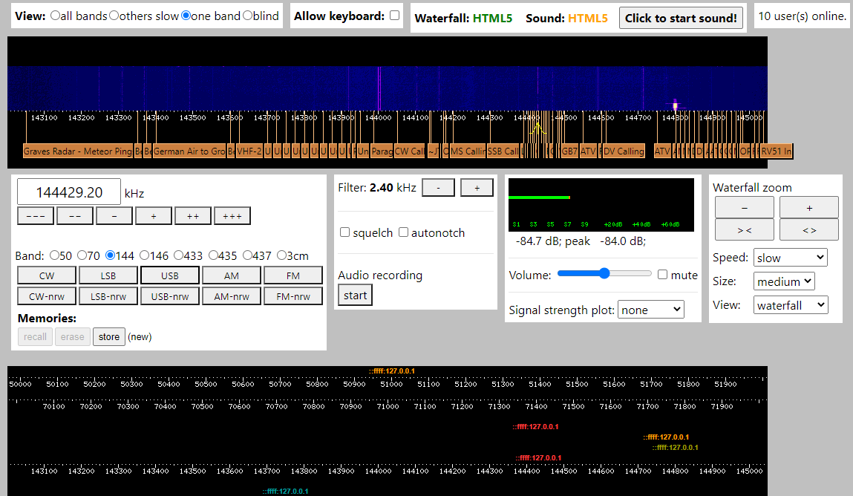
Using Web SDR
Is your tx working correctly?
Listen to other stations
Farnham (SUWS)
http://farnham-sdr.com/
Hack Green VHF/UHF
http://hackgreensdr.org:8902/
Jodrell Bank (G0XBU)
http://81.174.147.103:8901/
Netherlands: Loc JO21
http://sdr.shbrg.nl:8074/
Full list
http://www.websdr.org/
G2D / G3RAT - Drowned Rats Radio Group - www.g3rat.com

Slide 30
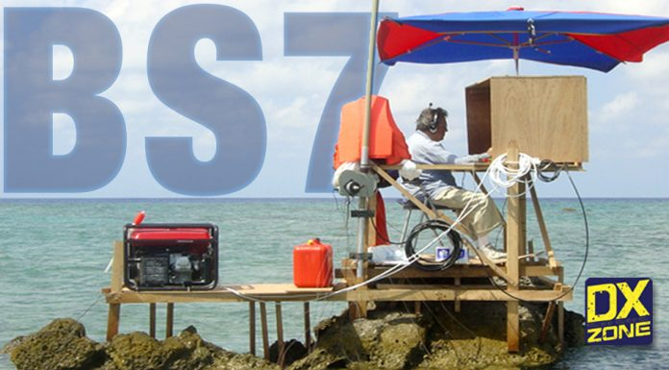
Getting Started – Where?
My home location is rubbish for VHF!
Doing better from home – dealing with domestic noise
Getting out portable
G2D / G3RAT - Drowned Rats Radio Group - www.g3rat.com

Slide 31
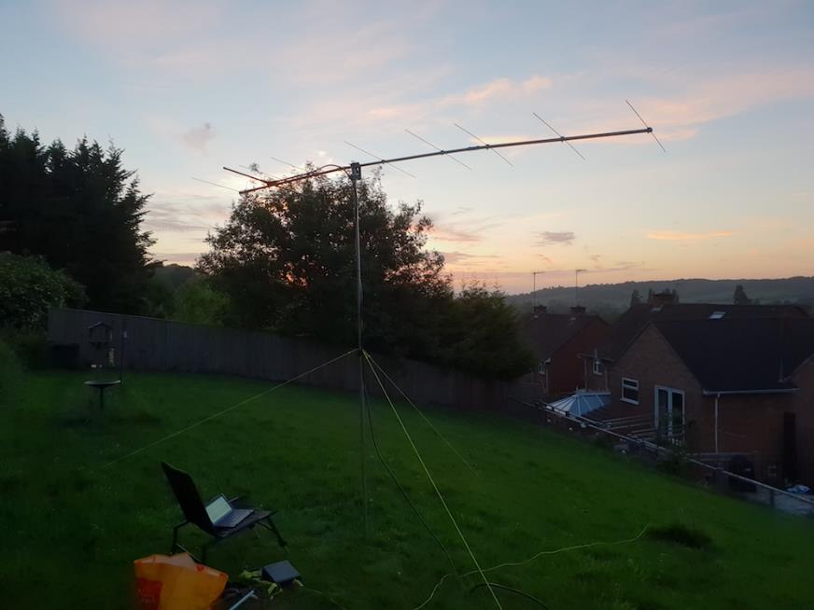
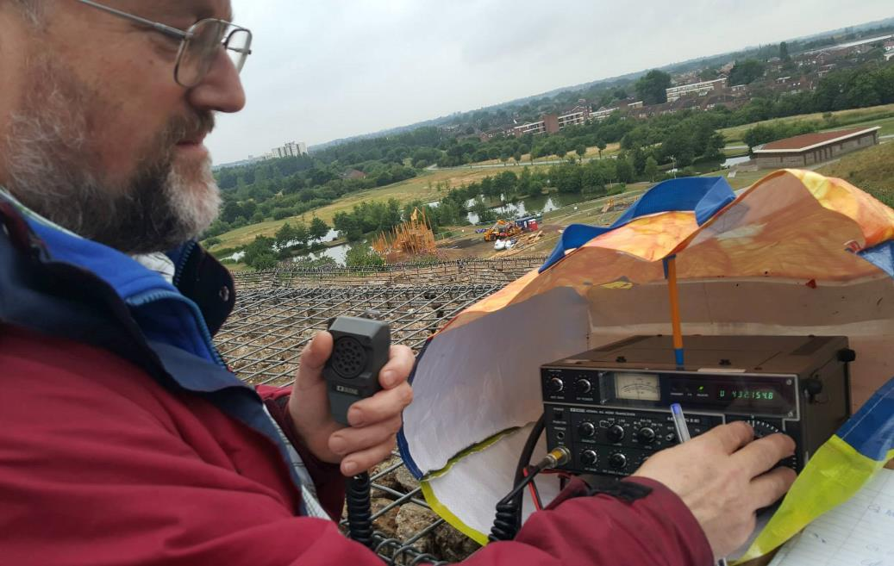
Getting Started – Portable
M0JCQ Back Garden
G0CAG Northala Fields
G2D / G3RAT - Drowned Rats Radio Group - www.g3rat.com

Slide 32
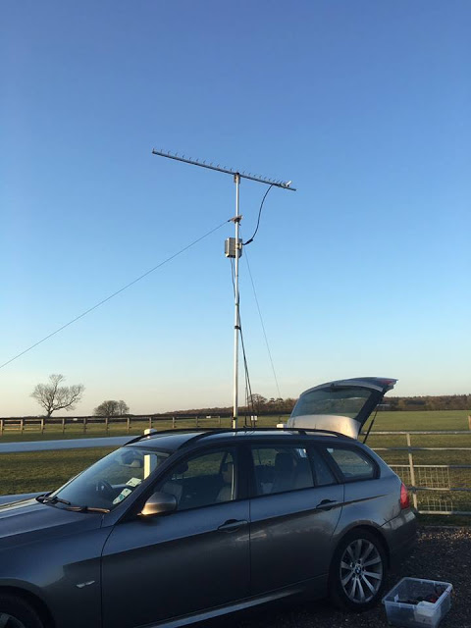
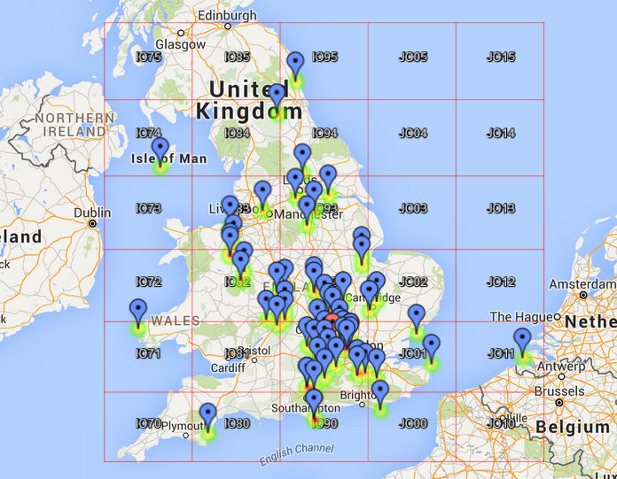
Getting Started – M0ICR Portable 23cm – 10W
G2D / G3RAT - Drowned Rats Radio Group - www.g3rat.com

Slide 33
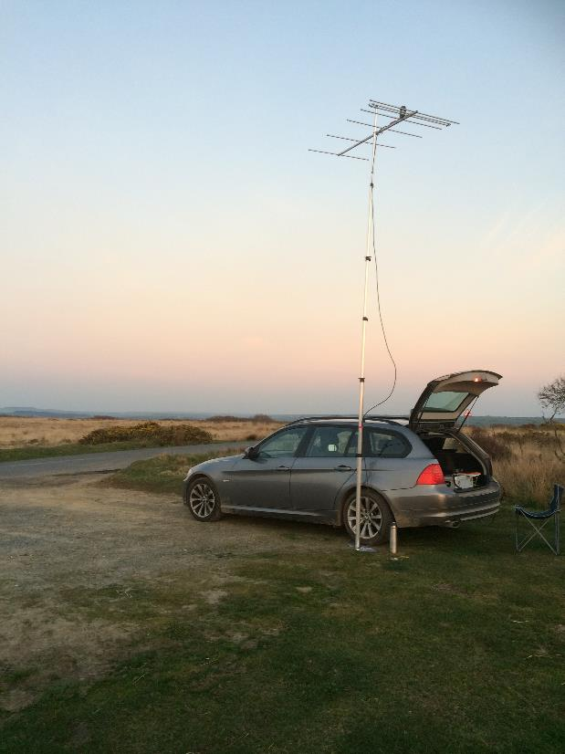
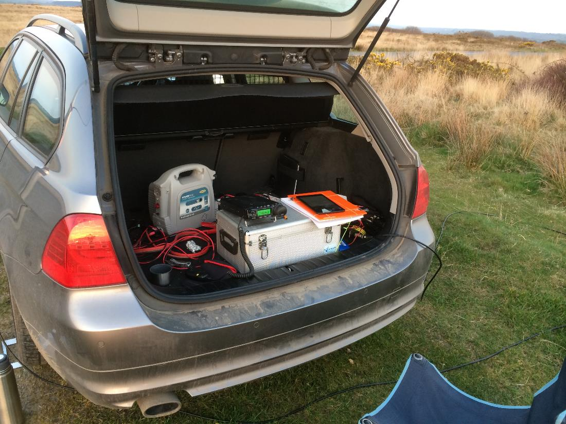
Getting Started – M0ICR Portable 2m near Bude, Cornwall
G2D / G3RAT - Drowned Rats Radio Group - www.g3rat.com

Slide 34
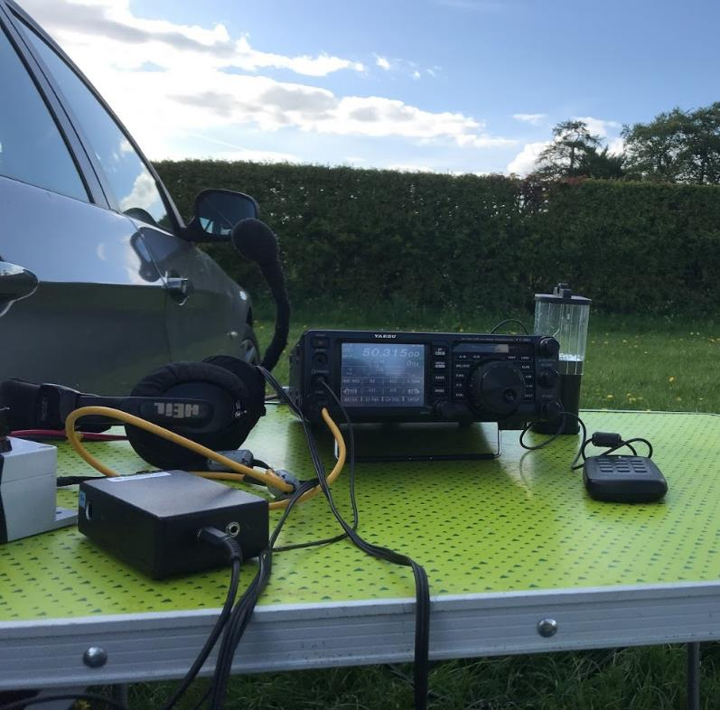
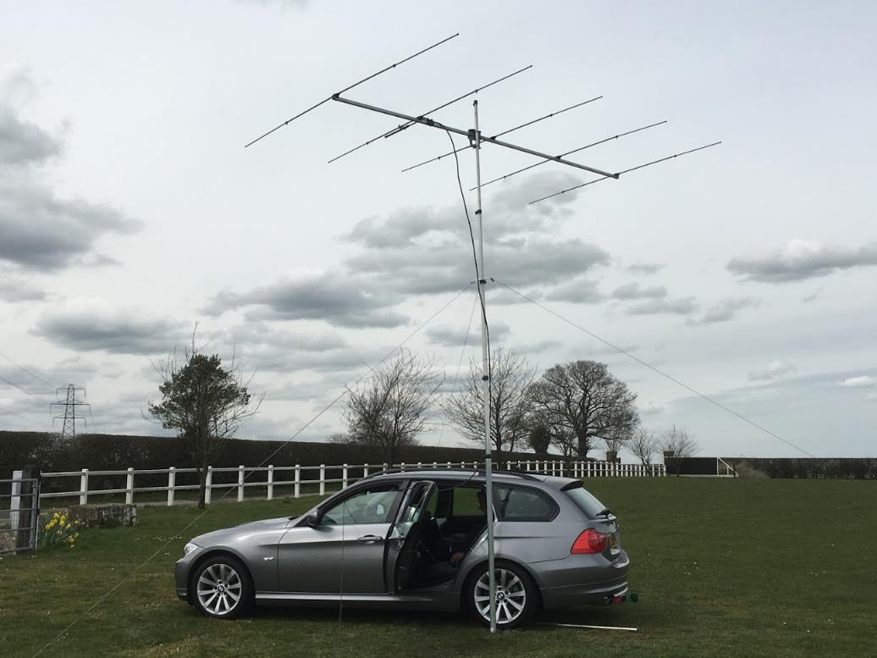
Getting Started – M0ICR Portable
G2D / G3RAT - Drowned Rats Radio Group - www.g3rat.com

Slide 35
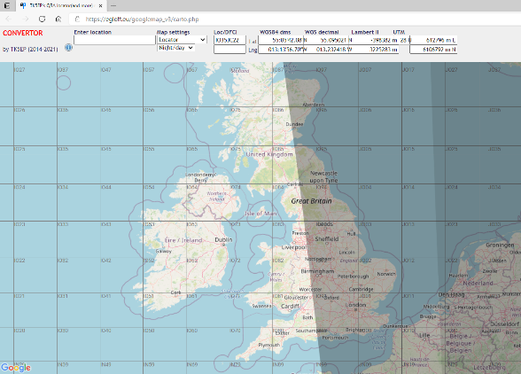
Getting Started – Location – Where
TK5EP’s QRA locator(and more) map (egloff.eu)
G2D / G3RAT - Drowned Rats Radio Group - www.g3rat.com

Slide 36
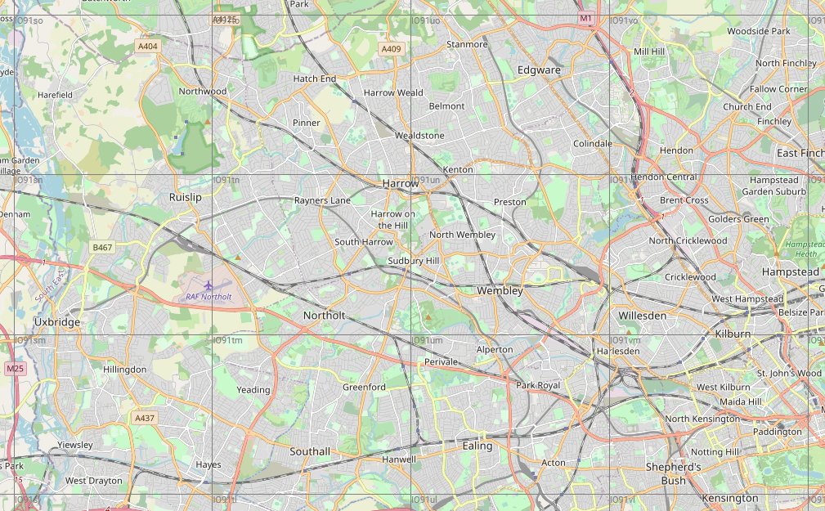
Getting Started – Location – Know your locator
G2D / G3RAT - Drowned Rats Radio Group - www.g3rat.com

Slide 37
Getting Started – Location – Know your locator
G2D / G3RAT - Drowned Rats Radio Group - www.g3rat.com

Slide 38
Getting Started – Location – Know your locator
IO91SO
IO91TO
IO91UO
IO91VO
IO91SN
IO91TN
IO91UN
IO91VN
IO91SM
IO91TM
IO91UM
IO91VM
G2D / G3RAT - Drowned Rats Radio Group - www.g3rat.com

Slide 39
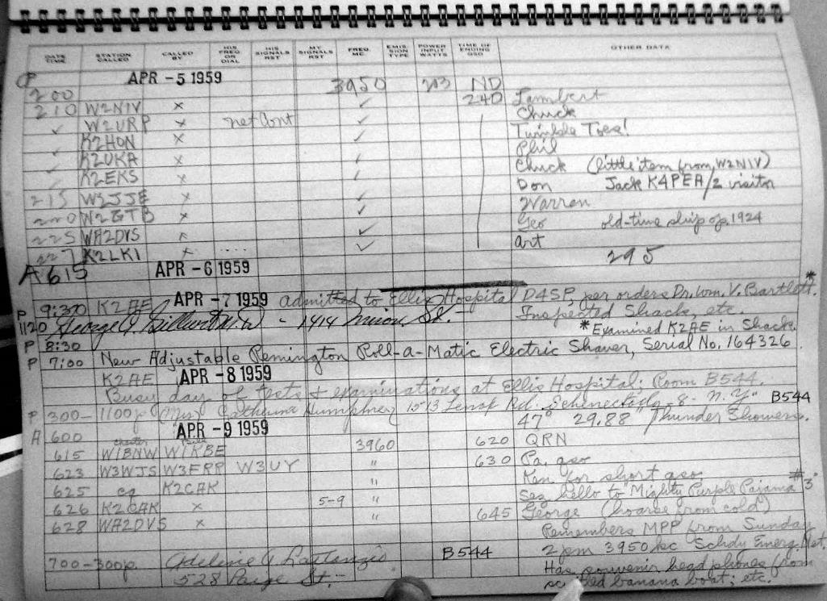
Getting Started – Logging and other tools
Paper logging
Minos is the tool of choice
But there are other options!
G2D / G3RAT - Drowned Rats Radio Group - www.g3rat.com

Slide 40
Part Two
Contesting UKAC
G2D / G3RAT - Drowned Rats Radio Group - www.g3rat.com

Slide 41
Contesting – UKAC
When
How
Club entries
The United Kingdom Activity Contest
Most Tuesday and Thursday Nights
Also note the FMAC: FM Activity Contest
G2D / G3RAT - Drowned Rats Radio Group - www.g3rat.com

Slide 42
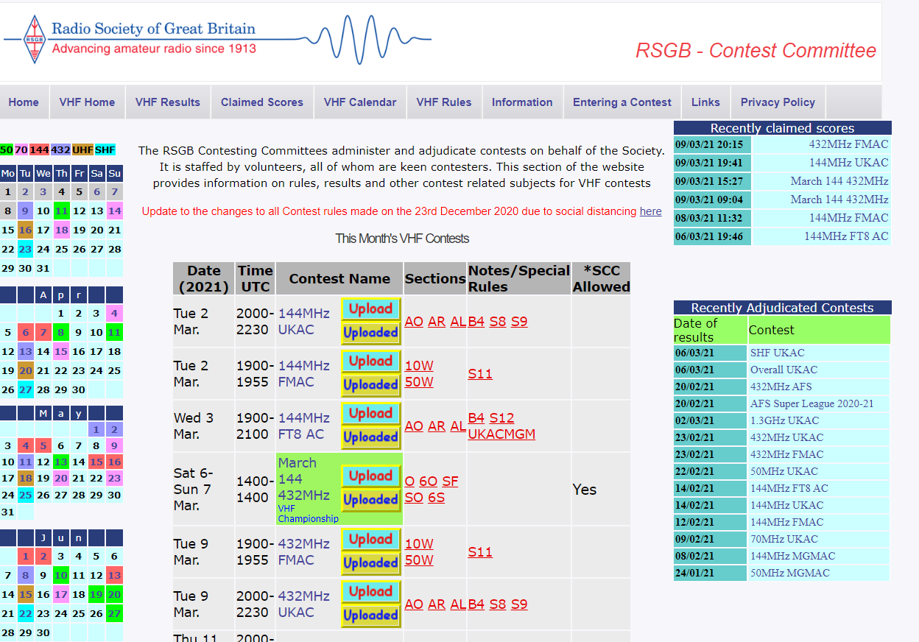
Contesting – RSGB VHFCC
https://www.rsgbcc.org/vhf/
G2D / G3RAT - Drowned Rats Radio Group - www.g3rat.com

Slide 43
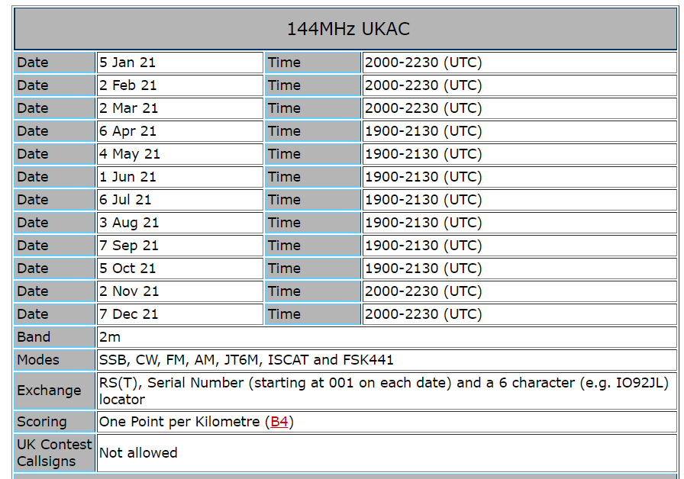
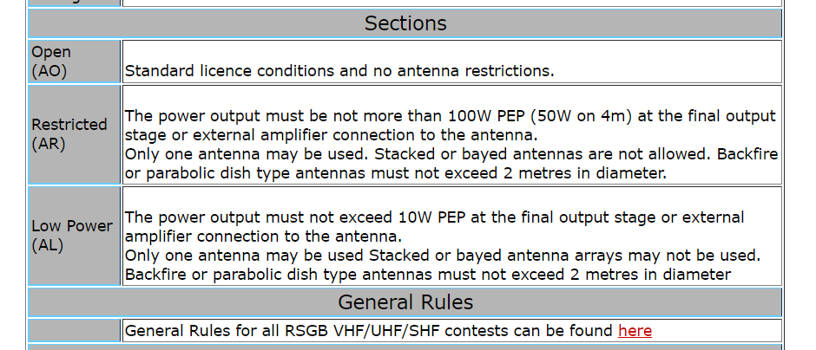
Contesting – UKAC - When
G2D / G3RAT - Drowned Rats Radio Group - www.g3rat.com

Slide 44
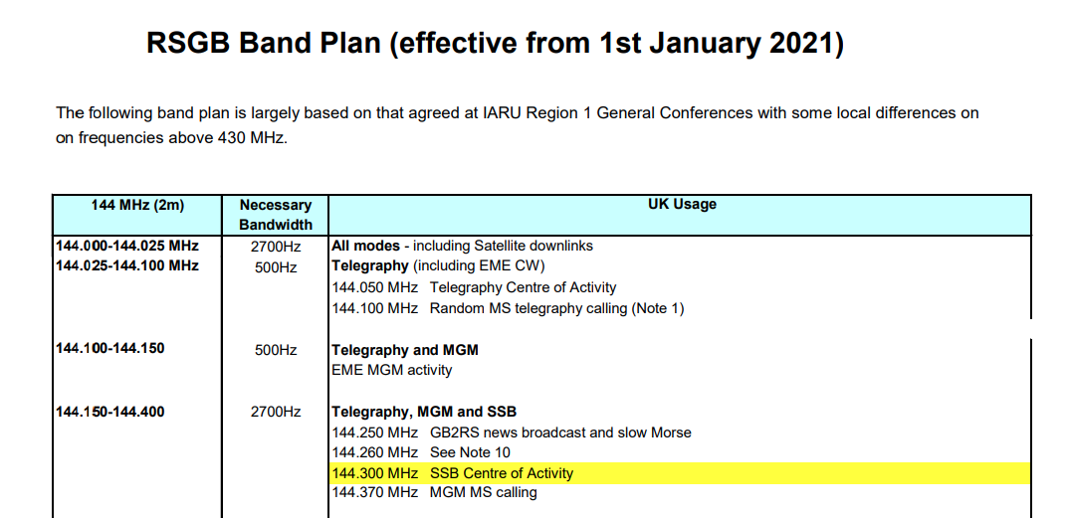
Contesting – Band Plans
https://rsgb.services/public/bandplans/docs/rsgb_band_plan_2021.pdf
Example – 2m
2m:
144.150 – 144.400 MHz
Avoid +/- 5KHz of 144.300
G2D / G3RAT - Drowned Rats Radio Group - www.g3rat.com

Slide 45
Contesting – UKAC - Multipliers
Basic score is:
Total Km + (500 x number of four figure locators)
Then normalised for relative position
Develop a strategy!
G2D / G3RAT - Drowned Rats Radio Group - www.g3rat.com

Slide 46
Contesting – UKAC – The contest exchange
Other station callsign
Signal Report
Serial Number
Your locator
G1ABC you are 5 and 9 009 in IO91AB
Please please get them in the correct order!
G2D / G3RAT - Drowned Rats Radio Group - www.g3rat.com

Slide 47
Getting Started – Logging - Minos
http://minos.sourceforge.net/
G2D / G3RAT - Drowned Rats Radio Group - www.g3rat.com

Slide 48
Contesting – UKAC – Entering Your Log
G2D / G3RAT - Drowned Rats Radio Group - www.g3rat.com

Slide 49
Contesting – UKAC – Entering Your Log
G2D / G3RAT - Drowned Rats Radio Group - www.g3rat.com

Slide 50
Contesting – UKAC – Claimed Score
G2D / G3RAT - Drowned Rats Radio Group - www.g3rat.com

Slide 51
Contesting – UKAC – some (more) top tips
It’s easy to get started (honestly!)
Listen, to get the cadence
Do as much as you are comfortable with, dip your toe
Set realistic goals – improve each time
Read the Rules and Read the Band Plan (avoid calling frequencies)
Ask – VHF contesters are a friendly bunch!
Join a contesting group – ‘The Rats’ welcome all members of RSH!
G2D / G3RAT - Drowned Rats Radio Group - www.g3rat.com

Slide 52
Part Three
DXing
G2D / G3RAT - Drowned Rats Radio Group - www.g3rat.com

Slide 53
Other useful tools and websites - Beacons
G2D / G3RAT - Drowned Rats Radio Group - www.g3rat.com

Slide 54
Getting Started – Airscatter
9
G2D / G3RAT - Drowned Rats Radio Group - www.g3rat.com

Slide 55
Getting Started – Airscatter
9
G2D / G3RAT - Drowned Rats Radio Group - www.g3rat.com

Slide 56
Getting Started – Airscatter
9
G2D / G3RAT - Drowned Rats Radio Group - www.g3rat.com

Slide 57
Other useful tools and websites - Airscout
http://www.airscout.eu/
G2D / G3RAT - Drowned Rats Radio Group - www.g3rat.com

Slide 58
Other useful tools and websites – Airscout - Airscatter
DL0GTH <> G3XDY
https://www.youtube.com/watch?v=g6IFVdu031s
G2D / G3RAT - Drowned Rats Radio Group - www.g3rat.com

Slide 59
Other useful tools and websites – Hepburn Tropo Charts
https://www.dxinfocentre.com/tropo_nwe.html
G2D / G3RAT - Drowned Rats Radio Group - www.g3rat.com

Slide 60
Other useful tools and websites – Make More Miles on VHF
MMMonVHF
G2D / G3RAT - Drowned Rats Radio Group - www.g3rat.com

Slide 61
Part Four
‘The Rats’
G2D / G3RAT - Drowned Rats Radio Group - www.g3rat.com

Slide 62
The Drowned Rats Radio Group
We are beginner friendly and love to train newcomers
…. but we also welcome ‘old hands’
½ price (£10 vs £20) - Special offer to RSH Members only
(offer valid to end March 2021)
G2D / G3RAT - Drowned Rats Radio Group - www.g3rat.com

Slide 63
The Drowned Rats Radio Group
VIDEO
G2D / G3RAT - Drowned Rats Radio Group - www.g3rat.com

Slide 64
The Drowned Rats Radio Group
DROWNED RATS SHOWREEL
https://www.youtube.com/watch?v=B3AonADU8uo
G2D / G3RAT - Drowned Rats Radio Group - www.g3rat.com

Slide 65
The Drowned Rats Radio Group – March 20 – 144/432 contest
144
432
VIDEO
G2D / G3RAT - Drowned Rats Radio Group - www.g3rat.com

Slide 66
The Drowned Rats Radio Group – Points mean prizes!
VIDEO
G2D / G3RAT - Drowned Rats Radio Group - www.g3rat.com

Slide 67
The Drowned Rats Radio Group - benefits
12 Reasons to Join The Rats
RSGB Affiliated Society
One of UK’s top VHF/UHF/SHF Contesting Groups – join a winning team – but no pressure
We are your local group – but have a number of RSH expats
Accessible and beginner friendly – on tap advice from experts
Age range 30 – 70+, G3’s to M6/7’s
Small enough for everyone to count and have a voice
We do more than contesting! Technical / Operating
Weekly events – do as much or as little as you wish
Loan store – radios, antennas, masts and more
Lively information hub
Monthly pub meetings, Online meetings, quizzes and webinars
Top class, well-equipped contest station and weekends away
½ price (£10 vs £20) - Special offer to RSH Members only
(offer valid to end March 2021)
G2D / G3RAT - Drowned Rats Radio Group - www.g3rat.com

Slide 68
Harrow special offer
Email: m1smh@drownedrats.uk or m0icr@drownedrats.uk
Or find out more at www.g3rat.com
Non-discounted membership link: https://www.g3rat.com/join-us-2/
G2D / G3RAT - Drowned Rats Radio Group - www.g3rat.com

